Slide 1
SALOON MANAGEMENT APP MINI PROJECT
SUBMITTED TO ;
SATHEESH KUMAR SIR
ASSISTANT PROFFESSOR
MARIAN COLLEGE AUTONOMOUS KUTTIKKANAM
SUBMITTED BY ;
ALBIN VINSON
22PMC106
MCA FIRST YEAR

Slide 2
Contents :
Overview / Abstract
Project requirements
Features and highlights
Technical aspects
Challenges faced
Future enhancements
Screenshots
Conclusion

Slide 3
Overview
What is this Project : This is a web-based application designed to help salon owners manage their business more efficiently.
Where is the Use : helpful for Salon owners can keep track of customers appointments and staff schedules.
What is the Reason : the problems identified in the traditional salons in the initial stages of the project.
Who do we Aim : develop an application that would be useful to small business owners in the salon industry.

Slide 4
Project requirements
User Authentication
Appointment Booking
Service Management
Responsive Design
Data Backup and Security

Slide 5
Features and highlights
The Saloon Management App has several key features that make it an essential tool for salon owners:
The Database has been designed to be easy to navigate. The dashboard provides an overview of all the important information, such as upcoming appointments and inventory levels.
One of the most important features is the appointment booking experience itself integrated with social media.
This web app allows salon owners to easily schedule appointments with clients and ensure that the customers to be on time to receive the necessary services.

Slide 6
It helps them save time by automating many of the tasks that would otherwise need to be done manually. This means that they can focus on providing high-quality services to their clients.
Helpful for salon owners to stay organized and keep track of important information like bookings, missed appointments
Finally, the app helps salon owners make better business decisions by providing them with real-time data about their business performance.

Slide 7
Technical aspects
The user interface of admin of the Saloon Management App is simple and intuitive and made from Django Jazzmin .
The Architecture is also easy to understand for basic developers and the code is written on Python with Django frameworks for better compatibility
The styling is done with the help of bootstrap and CSS for a colorful and yet interactive website

Slide 8
Challenges faced
One of the biggest challenges was ensuring that the app was user-friendly and easy to navigate.
Another challenge was integrating all the different features into a cohesive system that worked seamlessly.
However, these challenges were overcome through careful planning and collaboration between team members.
The end result is an app that is both functional and easy to use.

Slide 9
Future enhancements
1. Integration with Social Media Platforms:
This integration can allow users to share their salon experiences, book appointments directly through social media, or even offer special promotions through those platforms.
2. Staff Management Features:
Enhance the app with features to manage salon staff, such as a scheduling system to assign staff members to specific appointments or shifts, a staff performance tracking system, and a communication platform for internal staff messages and updates.
3. Customization and Personalization:
Offer customization options within the app, allowing customers to select their preferred stylist, service preferences, or any specific requirements they may have. This can help personalize the booking experience and enhance customer satisfaction.

Slide 10
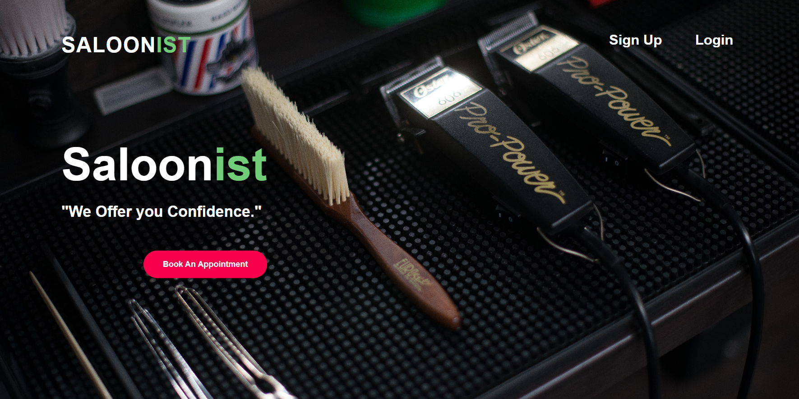
SCREENSHOTS

Slide 11
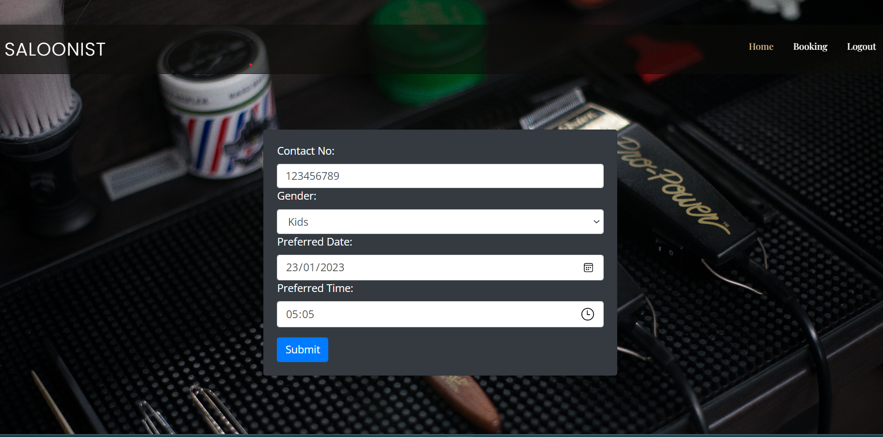
Booking PAGE

Slide 12
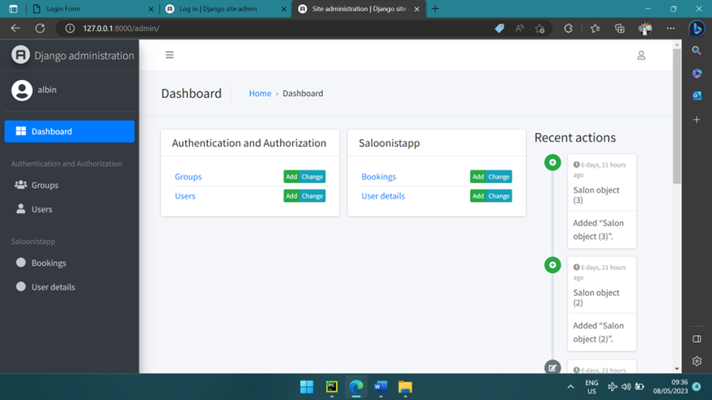
ADMIN PAGE

Slide 13
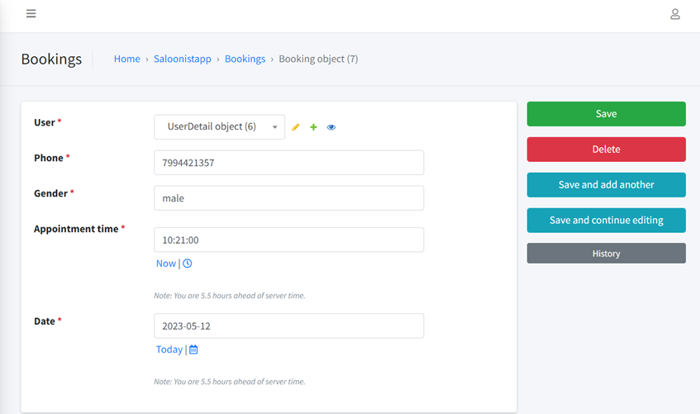
Booking details PAGE

Slide 14
Conclusion
In conclusion, the Saloon Management App Mini Project is a valuable tool for salon owners who want to manage their business more efficiently.
The app offers a range of features that help salon owners stay organized, save time, and make better business decisions.
Developing this app was a challenging but rewarding experience for the team. Iam proud to present this application that has the potential to make a real difference in the salon industry.

Slide 15
Thank you

